Slide 1
lit

Slide 2
About US

Slide 3
The project

Slide 4
Sprint 1

Slide 5
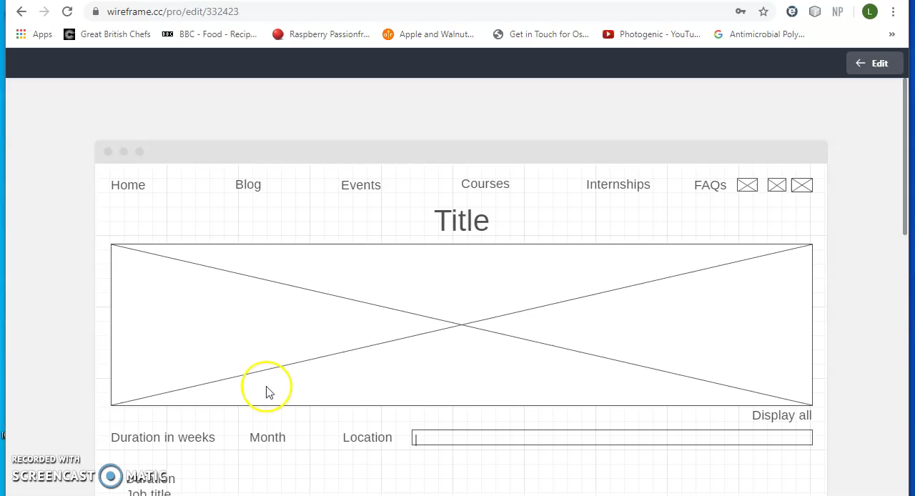

Slide 6
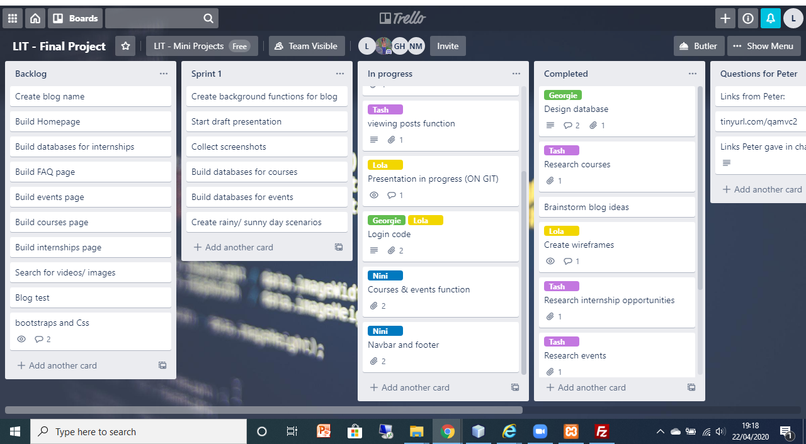

Slide 7
Sprint 2

